Slide 1
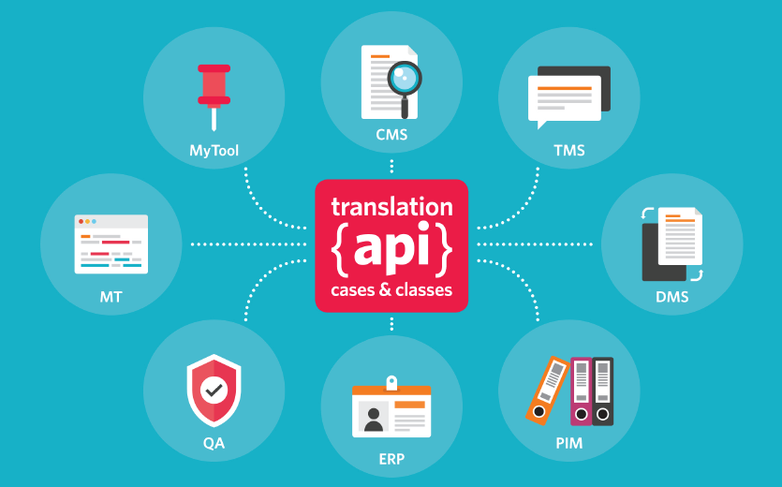
TAPICC: Translation Cases and Classes
Jim Compton
Program Manager, Partnerships Program,
RWS Moravia

Slide 2
Agenda
Introductions: Who is Jim? What is GALA?
Why and What is TAPICC?
Overview and Progress
Track 1
Track 2
Getting Involved
Let’s Chat!

Slide 3
Who is Jim?
~25-year veteran of the loc industry.
Have been deeply focused on CMS/TMS integration.
Manages RWS Moravia’s new Partnership Program.
My mission: Build a robust ecosystem of technology and services around our clients’ global programs.
Jim Compton, RWS Moravia

Slide 4
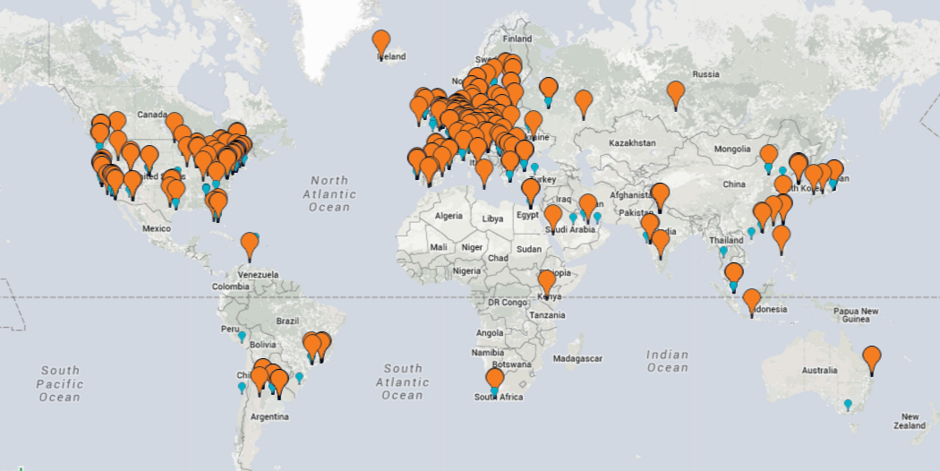
What is GALA?
Global non-profit trade association with membership of 400 companies (LSPs, tech developers, buyers of translation)
Non-biased platform for information-sharing and collaboration, training and professional development
Many organizational partnerships, including TAUS and LTI

Slide 5
GALA is the foundation of the TAPICC initiative.
Legal Framework
(Open Source)
The 3-Clause BSD License (BSD-3 Clause)
Community Engagement
GALA forum
Creative Commons Legal Code (CC-BY 2.0)
Working groups
GitHub wiki
Wide representation from the language industry
Organizational Documents
Project charter
Working Group Playbook
Numerous presentations and marketing collateral

Slide 6
Represent a CMS, DAM or similar tech?
Represent a TMS, CAT tool or similar tech?
Create / manage content that must get localized?
Responsible for localizing / translating content?
Any system integrators?

Slide 7
Why (and What Is) TAPICC?

Slide 8
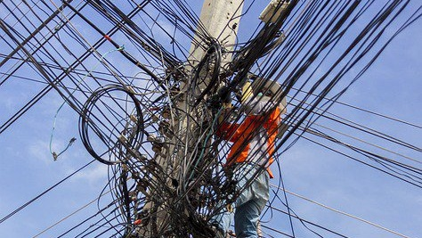
A brief history of the problem.

Slide 9
content management tech and practices
the CMS/TMS gap
mid-to-late 1990s
translation management tech and practices
Starts with: “How do I translate the content that I’m managing in my CMS?”

Slide 10
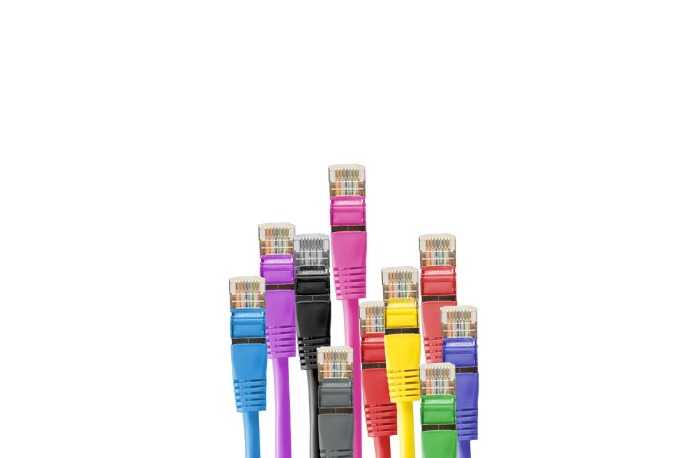
API Integration!
system-to-system communication
automation

Slide 11
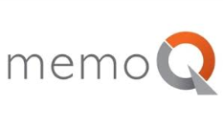
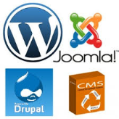
The rise of point-to-point integrations…

Slide 12
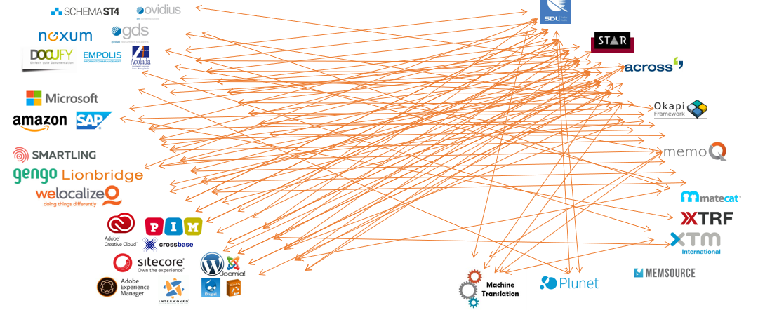
the “Wild West”
Unnecessary variation
Continuous reinvention of the wheel
Wasted $$!
For clients
For LSPs
For tools vendors
Loss of operational freedom
$
Can be a “deal breaker” for making content available worldwide!

Slide 13
The TAPICC Vision
My Content
My Tool
My Service
Common Integration model
Universal Translation API
Best practices
Use cases

Slide 14
TAPICC stands for: “Translation API Cases & Classes.”
It is:
an open, volunteer-driven pre-standardization initiative.
focused on use cases based on translation and language work.
It isn’t:
an attempt to replicate the functionality of CMSes or TMSes.
an attempt to dictate the actual flow of work through a supply chain or how work gets executed.

Slide 15
Features & Benefits
Agreed upon metadata, use cases, best practices, classes
Quickly implementable classes and use cases
Go-to place for information and education for ALL stakeholders
Reduce cost of integration
Quickly onboard new clients, systems, LSPs
Easily embed L10N in content processes and enterprises

Slide 16
Initiative is Organized into Four Tracks
We’ve been working on this…
Business metadata for supply chain automation
Exchange on unit level
Semantic enrichment of units
Harmonize existing business metadata models
Layout representation level
Pass a segment/unit from an editor to a TM/MT or other tool
Terminology, TM, MT, layout for “good enough”
Support process with visual context
1
2
…and are ramping-up with this.
3
Don’t confuse the tracks with the working groups. The working groups are there to divide-up the work within a track.
4

Slide 17
Track One: Supply Chain Automation

Slide 18
Track One Overivew
Business metadata for supply chain automation
Harmonize existing business metadata models
1
WG 1: Business Metadata
Define business-level metadata
WG 2: Payload Specification
Define types of payload
WG 3: XLIFF Extraction
Extraction guidance
WG 4: API Specification
Canonical names and values
Workflow relevance
Harmonization
Compatibility
Define payload-level metadata
Canonical names and values
Harmonization
Compatibility
ITS decoration
XLIFF Extractors/Mergers
XLIFF OM representations, e.g. JLIFF
Protocols
Transfer, pull and/or push
Define classes
Code samples/
snippets
Specify API
One of the principles of TAPICC is to leverage from relevant existing standards and standardization efforts, including (especially) XLIFF.

Slide 19
Progress So Far…
Business Metadata (WG 1)
Have defined a set of standard tasks types, and method for creating nuanced task has been defined (reflected in the REST specification).
Have created a business glossary of localization terms.
Basically done.
Payload Specification (WG 2)
Has created guidance around payload that will be summarized in a short prose deliverable.
Evaluating similarities and aligning with the Language Interoperability Portfolio (Linport) initiative.

Slide 20
Progress So Far…
XLIFF Extraction (WG 3)
“XLIFF 2 Extraction and Merging Best Practice” document being contributed to OASIS (good example of how pre-standardization efforts can become standard).
Still need to support the community with real-world extraction problems.
API Specification (WG 4)
RESTful specification candidate (in Swagger format) evolving though healthy debate on GitHub.
Underlying data model continues to be refined.
Prose deliverable being authored and edited by a small team.
Various parties discussing reference implementations.

Slide 21
WG1 Complete Set of Task Types
The final deliverable will include the parameters for each of these task types
Localization
Internationalization
Scoping
Translation
Editing
Checking
DTP
Terminology work
Transcription
Content Creation
Content Preparation

Slide 22
Commenting on WG1 Results
Elementary Linguistic Task Types https://docs.google.com/document/d/1POWcoIrwKvUQpgq_ImgcpK_p6PZ35k7g7mieKARGgR4/edit?usp=drive_web&ouid=113136557825967529407
Glossary of terms for the L10N industry https://docs.google.com/document/d/1OvYksscrYGtz7gUK-25AR28jobRN7gtkNtu1W3rvgaA/edit

Slide 23
WG2 Consensus
Prose deliverable:
Primary goal of TAPICC is translation round trip. Other task are considered only as far as they support achieving the primary goal.
Payload is driven by task type.
If task type involves bitext, XLIFF2 is mandated. Legacy bitext is considered as source format and will be extracted into XLIFF2.
Details around reference data
Evaluating similarities and aligning with the Language Interoperability Portfolio (Linport) initiative / ASTM

Slide 24
WG3 Output
WG3 focuses on XLIFF extraction from native format and providing buyers with guidance on how to create XLIFFs that simplify satisfying their needs.
Examples of problematic approaches and suggested better alternatives can be found in https://galaglobal.github.io/TAPICC/
The release of this specific output “XLIFF 2 Extraction and Merging Best Practice” version 1.0 is here: https://galaglobal.github.io/TAPICC/T1/WG3/rs01/XLIFF-EM-BP-V1.0-rs01.xhtml

Slide 25
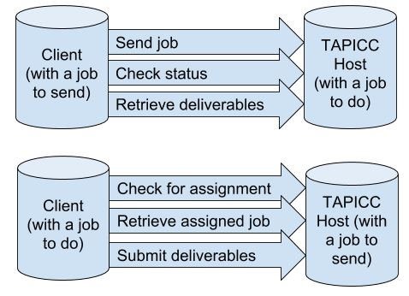
WG4 Model in a nutshell
TAPICC Exchange types:
Client or host can be any type of system: CMS, TMS, etc.

Slide 26
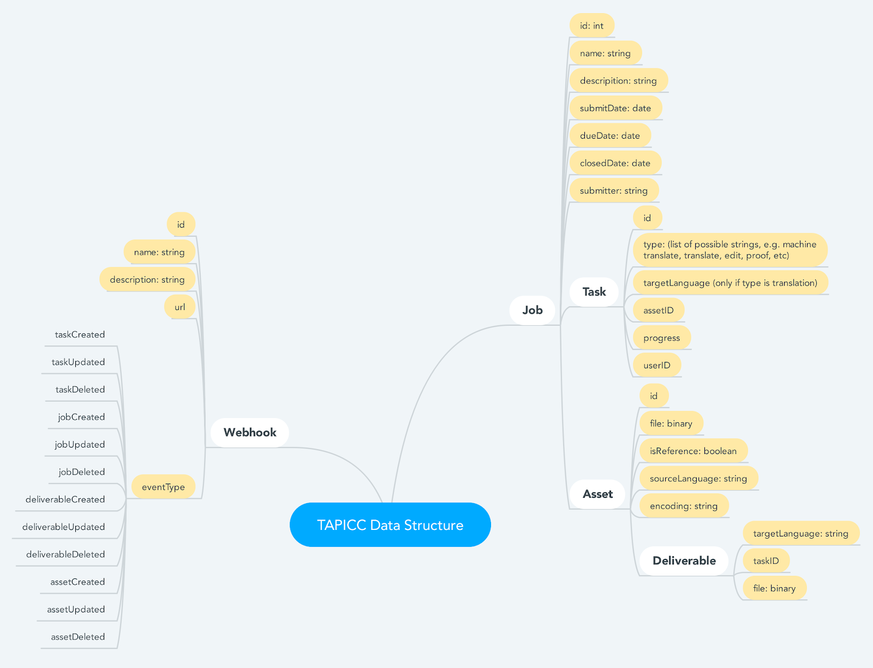
The nuance of the data model is currently being debated / refined. But here’s the gist: supply chain interactions are modelled by bodies of work (jobs, tasks) that are associated with different types of content (assets, deliverables, and reference material) being exchanged between any two parties in the chain.

Slide 27
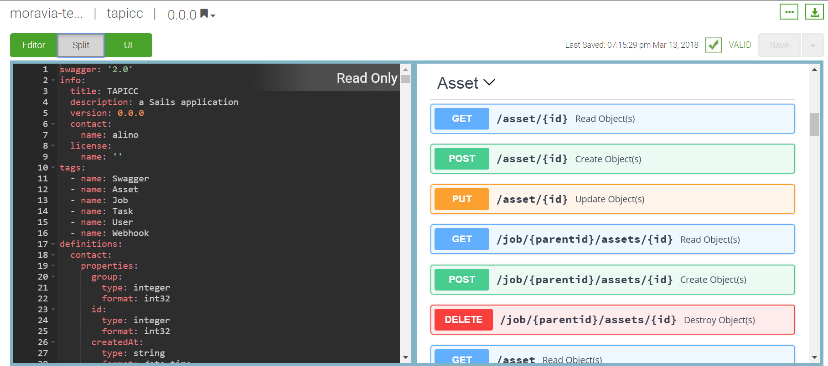
Available as a Swagger document

Slide 28
Track Two: Unit-level Exchange

Slide 29
Track Two Overview
Exchange on unit level
Pass a segment/unit from an editor to a TM/MT or other tool
2
T2 addresses instantaneous fragment level exchange between agents operating on bitext units such as TMS, MT Broker MT Engine, Translation editor etc.
JRARTEBU!* *JLIFF REST API for Real Time Exchange of Bitext Units
Track 2 charter: https://www.gala-global.org/sites/default/files/uploads/pdfs/TAPICC_Track2_Charter.pdf
Track 2 WG1 Connect Group: https://www.gala-global.org/tapicc-t2wg1-jliff-rest-api

Slide 30
T2 as opposed to T1
T1 scope is Supply Chain Automation, job level exchange between
Organizations such as customer, MLV, SLV, MT Provider, Tool Provider, Freelancer, etc. and
Agents such as CMS, TMS, MT Broker, MT Engine, Translation Editor etc.
T1 transactions are always asynchronous and exchanging the whole bulk of the job.
T2 addresses instantaneous fragment level exchange between
Agents operating on bitext units such as TMS, MT Broker MT Engine, Translation editor etc.
In real time, as synchronous transactions

Slide 31
T2 Use Cases
TMS
Translation Editor
TMS
TMS
TMS
MT

Slide 32
Other Resources for Track 2
OASIS XLIFF OMOS TC https://www.oasis-open.org/committees/tc_home.php?wg_abbrev=xliff-omos
OASIS XLIFF OMOS TC - JLIFF Repository on GitHub https://github.com/oasis-tcs/xliff-omos-jliff
Vistatec’s Phil Ritchie – JLIFF C# library (MIT License) https://github.com/vistatec/JliffGraphTools

Slide 33
Getting Involved

Slide 34
How You Can Help
Track 1 is ready for
Feedback on the deliverables
Input
Help with finalizing the API
Reference implementations
Track 1 goal is to be finished by GALA Munich
Track 2 is looking for volunteers
Face2face meeting of Track 2 team at GALA Munich preconference day

Slide 35
How to Join
Joining does NOT require GALA membership, but it DOES require setting up an account and accepting the legal agreement.
Set up an account:
https://www.gala-global.org/user/register
Register as a new member.
Join the Connect Group for TAPICC:
https://www.gala-global.org/community-groups
Search for “TAPICC”.
Select the group.
Click on “Join this group”.
Click through and accept the legal.
(If you are representing an organization, you probably need to talk to your legal department. https://www.gala-global.org/tapicc-legal-agreement.)

Slide 36
Thanks!

Slide 37
TAPICC Resources
https://www.gala-global.org/TAPICC
Project Charter
Open Source Legal agreement
Project Statement
TAPICC Groups
Various links

